Slide 1
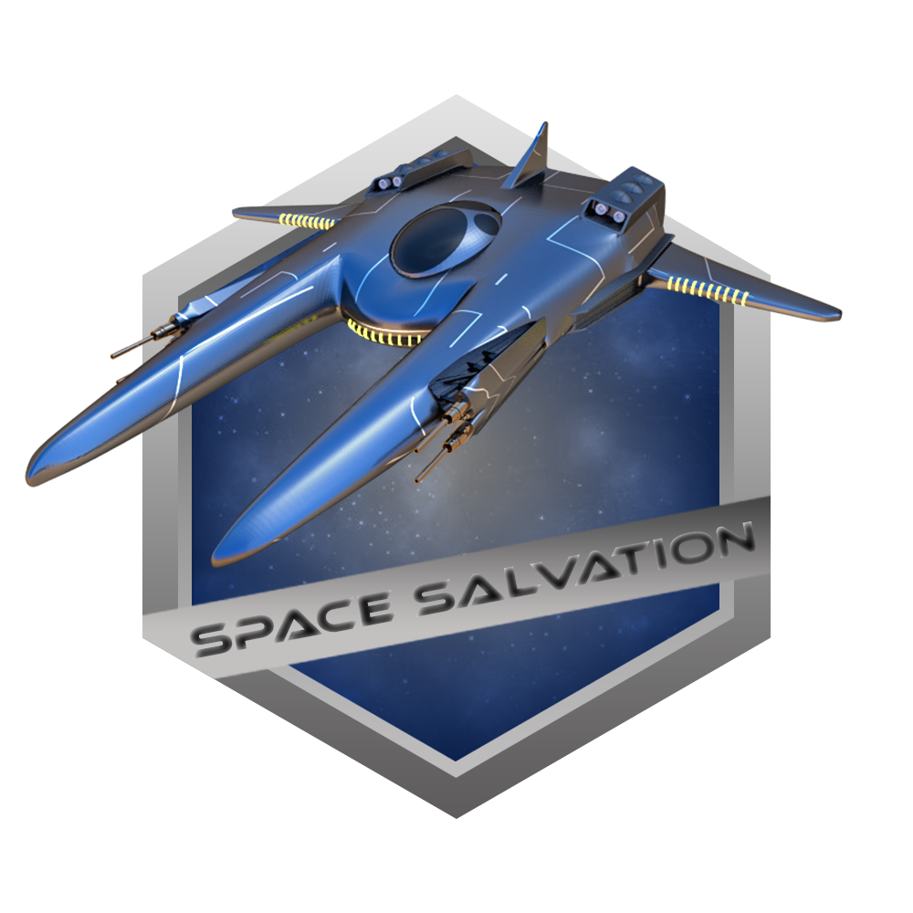
Space Salvation

Slide 2
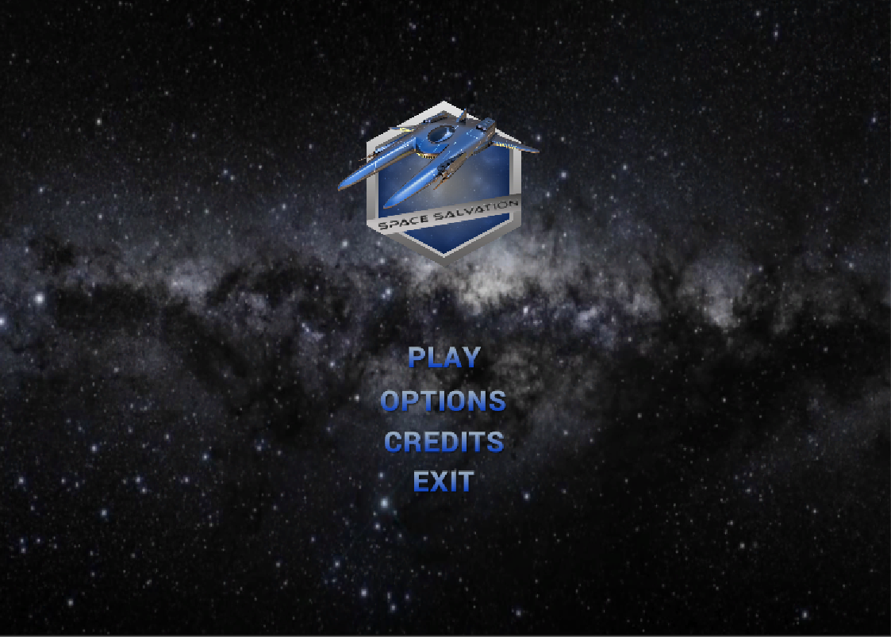
Start Menu

Slide 3
Controls
Movements
Ship movement
Speed boost
Shooting
Regular shooting
Nuclear shooting
Mouse navigation
Left shift
Mouse right click / Space
?? Button

Slide 4
Health, score, lives and death conditions
Health
Initial value 100%
Each hit decrease by 20%
Each Health kit adds 20%
Score
Each star adds 100 points
After 1000 points collected, 1 extra life granted
After each level completion + 200 points
Lives
Initial quantity 3
After each 10 stars collected = 1 live
Death
Once all lives lost
Once being hit with asteroid

Slide 5
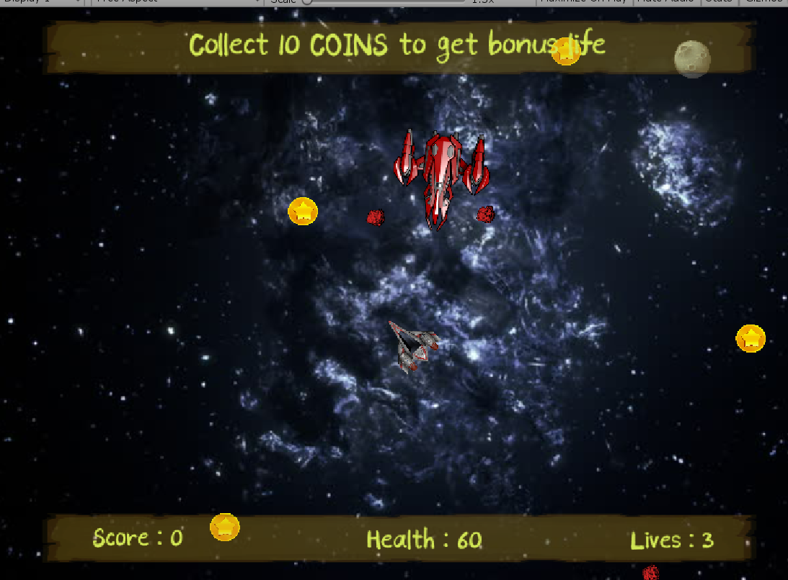
Level 1
Task:
Dodge the enemy’s bullets and shoot back
Each hit reduces Enemy’s health by ?? %
Collect coins to get extra points / life
Collect health kits; each adds 20%
Dodge asteroids!

Slide 6
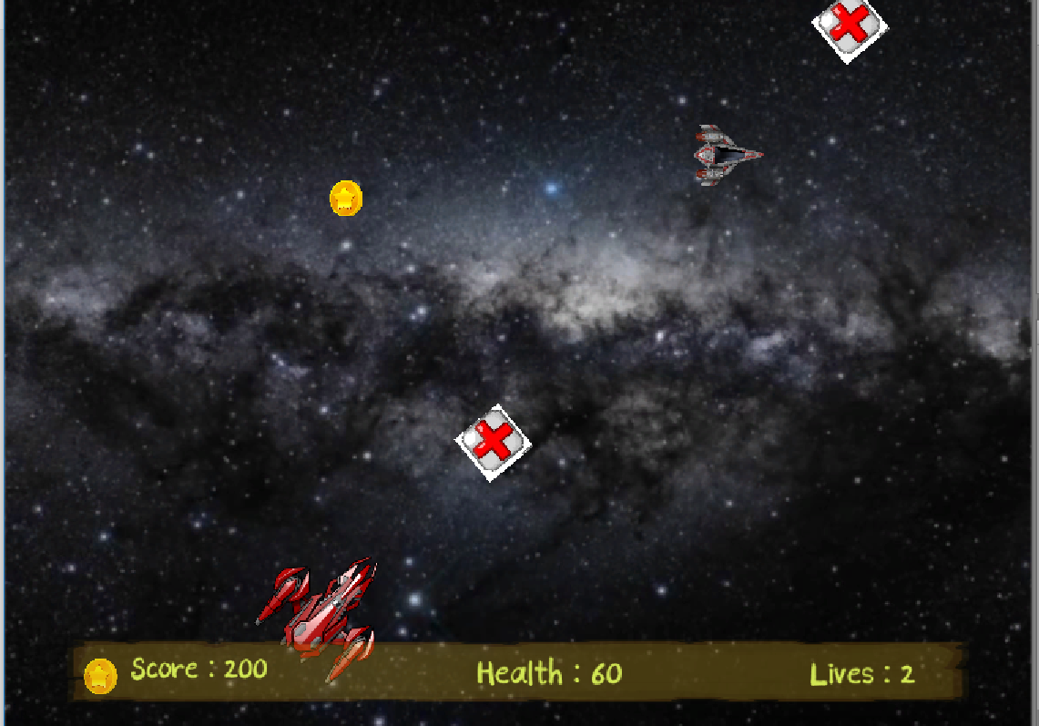
Level 2
Task:
Dodge the enemy’s bullets and shoot back
Each hit reduces Enemy’s health by ?? %
Collect coins to get extra points / life
Collect health kits; each adds 20%
After first enemy destroyed, expect second one!

Slide 7
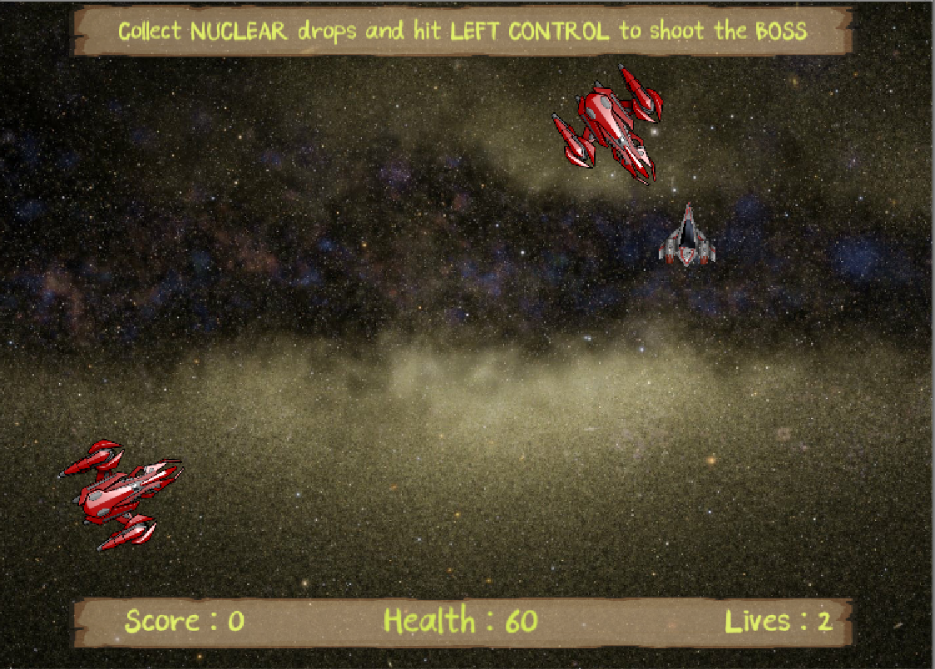
Level 3
Task:
Enemies shoot simultaneously!
Dodge the enemies’ bullets and shoot back
Each hit reduces Enemy’s health by ?? %. After destroy, collect nuclear drops they emitting
After enemies destroyed, Boss comes to the scene
Use regular bull

Slide 8
Level 3
Task:
After enemies destroyed, Boss comes to the scene
Use regular bull

Slide 9
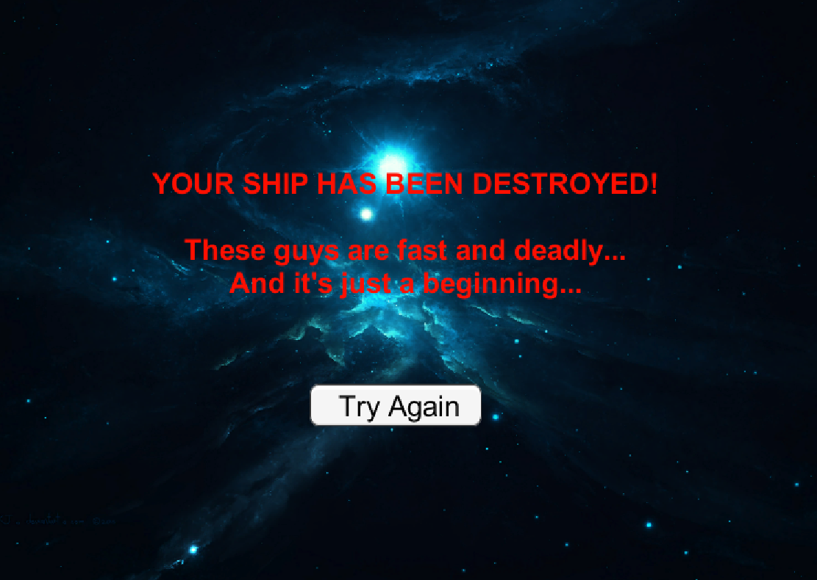
DEATH page

Slide 10
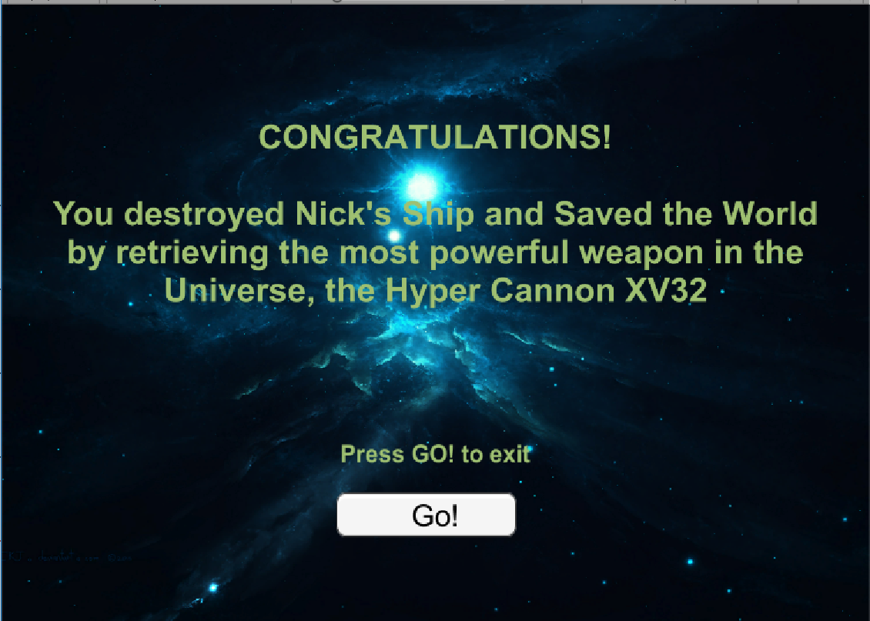
WIN page

Slide 11
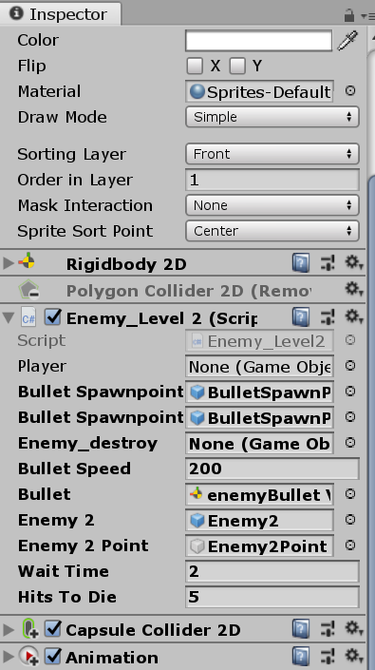
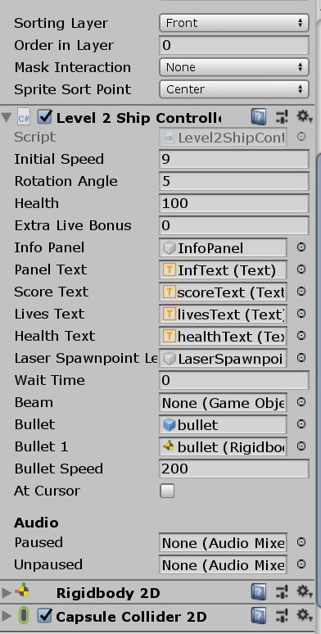
Complexity adjustments

Slide 12
Discoveries Challenges
Work on the levels of objects
Work on the levels of entire components
Building game with no coding
Quaternions
Mouse facing
Specific sound tracks control
Animation

Slide 13
How game could be modified
Replace mouse control with arrows one
Adding gamepad control functionality
Implementation of camera following ship to extend game world
Adding animated background
Adding blaster beams in shooting

Slide 14
QUESTIONS?

Slide 15
THANK YOU !

